Slide 1

Nurse Coaching & Resilience (NCR Health)
Team 30
Lyn McCright, MPH, APRN, AGNP, AHN-BC, HWNC-BC
254-644-6251
Lyn@nursecoaching.com
Notes:
NCR Health [https://ncrhealth.com]
Ideal Sponsors:
Robert Wood Johnson Foundation
Johnson & Johnson
Microsoft, Inc.
Team Leads
Lyn McCright, MPH, APRN, AGNP, AHN-BC, HWNC-BC owner, Advancing Nurse Coaching online coaching program, Lyn@nursecoaching.com
Teresa Walding, BSN, RN, NC-BC, Faculty, Advancing Nurse Coaching teresa@nursecoaching.com
Shelli-Ann McKenzie, MS, RN, PMP, Clinical Informatics Strategist, Nurse Leader, Founder Help for Healthcare Professionals, Inc., Co-Founder of Black Women Leaders in Nursing, North Georgia Community Health Leader
shelliann.mckenzie@hhcpinc.org LinkedIn https://www.linkedin.com/in/shelliannj/
Vadim Kacherov, Microsoft
Brainstorm Team Members:
kklarivee
cqperez200@gmail.com
Laura Deschere <LauraDeschere@gmail.com>

Slide 2
The Problem
In the rush of our daily workflow, we forget the fact that we, ourselves, are the most important part of the healing equation.
When we meet our own needs, in the moment, we can then meet our patient's needs.
Notes:
The Problem
Slide content
We teach the art and science resilience of for Nurses, Nurse coaches and health professionals. Nurse coaches are the way of the future of health care. It is through nursing and health professionals that we will create a healthy world using the concepts of our program to take care of the nurse first and generalizing throughout the healthcare system.
Self-care is as simple as noticing our next personal need…and satisfying that need
If you are thirsty…take a drink
"THE TIME FOR RESILIENCE IS NOW... [QUOTE FROM LYN]"
Our team has the collective experience in coaching, implementation, and technology to develop a scalable solution essential for today's healthcare environment.

Slide 3
The Solution
We are changing the way Health is viewed from within... and how change is created.
Notes:
It all begins with a thought first… the rest will be a natural evolution of change from within.
This change will transform the healthcare system.
Our company, will transform the care of the resilient nurse and help other healthcare professionals.
We will work collaboratively to identify components of platform to adopt within specifiied setting (ICU, Pediatrics, etc.)
How does it work?
Transmitting reminders via visual lighting, images, and messaging in real-time in the clinical environment; sent from loved ones.
NCR Health will market to
Hospitals and Provider organizations [Public, Private, Non- Profits and Federal]

Slide 4
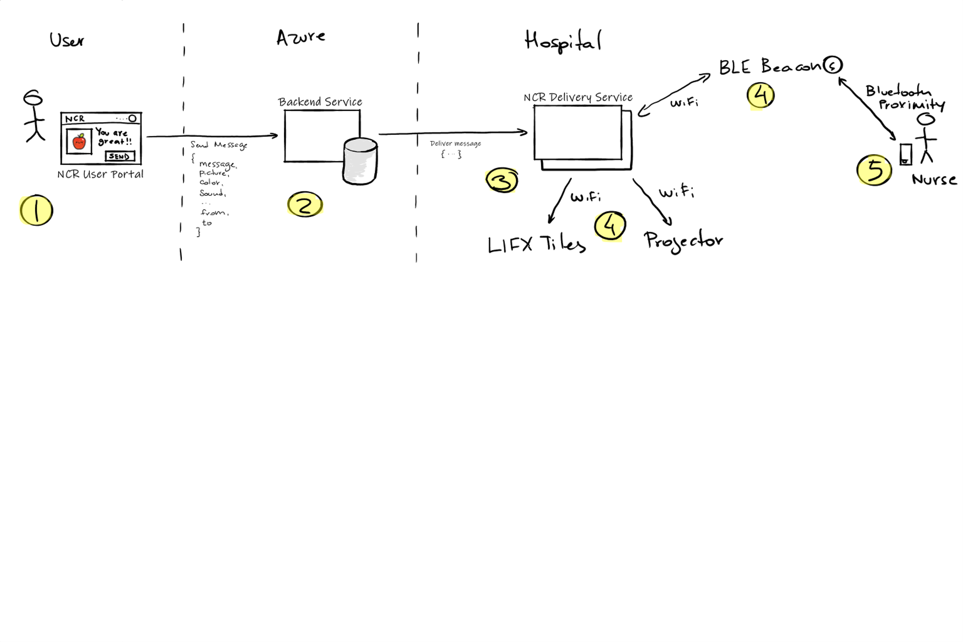
Technical Architecture
Notes:
User
User portal accessed via web to send personal message to a specific nurse
-color, sound, messages, graphics, handwritten notes
Azure Tech (Cloud)
Rest Based API Backend service collects data from website in JSON format
Hospital
Fetches new messages from backend service in the cloud
Sends configuration updates to LEF tiles and projector over wifi
Nurse
Installs NCR mobile app (like beCo), using bluetooth beacon and nurses mobile phone proximity
NCR delivery service will play personalized message and change lights play images, sound, etc.
Implementation & Scalability
This is easy to implement because of existing technology and readily available
Scales easily, its more inclusive, one LED per unit...it helps families stay connected.
PROMPTS NURSES TO REMEMBER THEIR PURPOSE AND DECREASES ANXIETY...INCREASING RESILIENCE.

Slide 5
Questions
???

